Slide 1
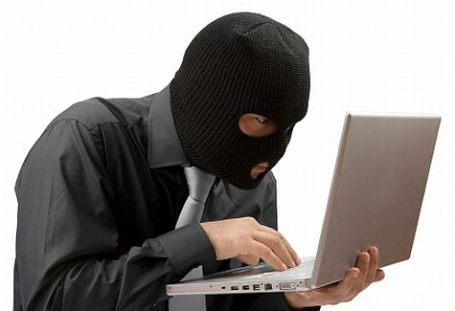
Identity Theft
Notes:
This presentation will focus on identity theft. What do you already know about identity theft? Do you know anyone who has had their identity stolen?

Slide 2
What is Identity Theft?
Identity theft is a serious crime. Identity theft happens when someone uses information about you without your permission. They could use your:
Name and address
Credit card or bank account numbers
Social Security number
Medical insurance account numbers
Notes:
Identity theft is a crime! It occurs when someone wrongfully obtains and uses another person’s personal data in some way that involves fraud or deception. Identity theft can occur through the use of your name and address, credit card or bank account numbers, medical insurance account numbers, and one of the most common is the social security number. Keep in mind that this is not the only personal information that can be wrongfully used.

Slide 3
Why should I care if someone steals my identity?
You will be responsible for what the thief does while using your personal information. You might have to pay for what the thief buys. This is true even if you do not know about the bills.
How can that happen?
A thief might get a credit card using your name.
He changes the address.
The bills go to him, but he never pays them.
That means the credit card company thinks you are not paying the bills.
That will damage your credit.
Notes:
It is very important to be aware of identity theft. Ultimately, you are responsible for what the thief does while he is wrongfully using your personal information. If the thief purchases items with your account, you may have to pay for what is purchased. This is still true even if you do not know about the bills. A scenario of this could be if a thief gets a credit card using your name and changes the address. The bills will then be sent to the new address but the thief will not pay for the bills that are sent. This means that the credit card company thinks that you are just ignoring your bills which will damage your credit history.

Slide 4
What can a thief do with my personal information?
An identity thief can use your name and information to:
Buy things with your credit cards
Get new credit cards
Open a phone, electricity, or gas account
Steal your tax refund
Get medical care
Pretend to be you if they are arrested
Notes:
An identity thief can do more than just harm your credit score or still your money. They can buy things with your credit cards, get new credit cards, open various accounts, steal a tax refund, get medical care, and even pretend to be you if they are arrested. This is why it is so important to be aware of identity thief.

Slide 5
How can a thief steal my identity?
A thief can get your personal information in person or online. Here are some ways thieves might steal someone’s identity. A thief might:
steal your mail or garbage to get your account numbers or your Social Security number.
trick you into sending personal information in an email.
steal your account numbers from a business or medical office.
steal your wallet or purse to get your personal information.
Notes:
Years ago, people just thought that identity thief could occur when your wallet or actual items were stolen from your possession. Today, it can happen in that form and it can also happen online and through the use of technology. Some common ways that identities can be stolen are listed. People can steal your mail or search through your garbage to obtain personal information such as account numbers and your social security number. People can also send spam emails that may trick you into sending personal information. A person looking to steal someone’s identity could also take account numbers from a business or even a medical office. A very common way in which this can occur is when someone physically steals a wallet or purse to obtain your personal information.

Slide 6
How do I know if someone steals my identity?
Sometimes, you can tell if someone steals your identity.
Read your bills. Do you see charges for things you did not buy?
Watch your bank account statement. Are there withdrawals you did not make? Are there changes you do not expect?
Check your mail. Did you stop getting a bill? Or did you start getting a new bill you do not know about?
Get your credit report. Are there accounts or other information you do not recognize?
Notes:
So you may be wondering how you would ever figure out if your identity was stolen. Well, here are a few ways that may warn you that your identity may have been stolen. You should always read your bills to be sure that there are not charges for things that you did not purchase or order. It is very important to always keep an eye on your bank account statement and make sure that you are familiar with all of the charges on your account. Be sure to check your mail as regularly as possible. Be aware of bills and other important pieces of mail. Did you stop getting a bill or did you start getting a new bill that you did not know about? You should pull your credit report at least once per year. Once you have received your credit report, you should review it carefully and sure that you are familiar with all of the accounts and information listed.

Slide 7
What is a credit report?
Your credit report is a summary of your credit history. It lists:
Your name, address, and Social Security number
Your credit cards
Your loans
How much money you owe
If you pay your bills on time or late
Credit Inquiries
All the information in the credit report should be about you. Get a copy of your credit report. Make sure you recognize the information in it. If you do not, you need to try to fix it.
Major Credit Report Agencies: Experian, TransUnion, and Equifax
Notes:
A credit report is a summary of your credit history. It includes your identifying information such as your name, address, social security number, date of birth, and employment information. This does not affect the scoring, it is just used to identify you. Your credit card accounts are also listed with the date you opened the account, the credit limit or loan amount, the account balance, and the payment history. The loans that you have are also on a credit report. These could be car loans, school loans, or mortgages for a home. The credit report will show how much money you owe on your credit accounts and loans. Payment dates for these is also listed on the credit report. One interesting thing about the credit report that many people do not know about is credit inquiries. When you apply for a loan, you authorize your lender to ask for a copy of your credit report. This is how inquiries appear on your credit report. The inquiries section contains a list of everyone who accessed your credit report within the last two years.
When reviewing your credit report, you should be sure that all of the information is about you. If you do not recognize all of the information, you should take action immediately.
There are three major credit report agencies. They are Experian, TransUnion, and Equifax. These agencies collect and maintain the information that forms your credit history and ultimately, your credit report. These companies are all for-profit private companies and they do not share information with each other.

Slide 8
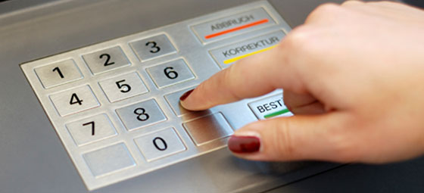
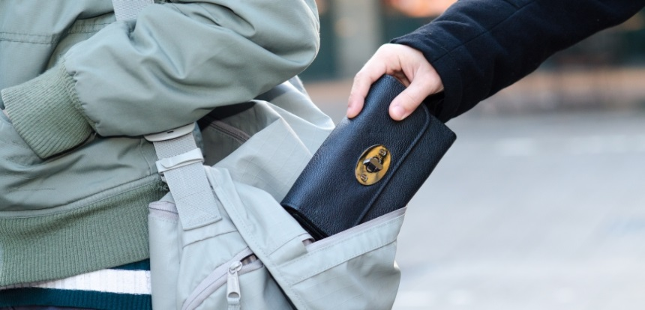
How can I protect my identity?
In a Store:
Always watch your wallet.
Be careful with your credit card or debit card.
Do not tell anyone your PIN number.
Notes:
There are many actions that you can take in order to protect your identity. When you are in a store or public place, be sure to always watch your wallet or your purse. This will lower the risks of your personal information being stolen. Always be careful with your credit and debit cards. Keep them in a safe place and be alert when you are making a purchase with them. Never tell anyone your PIN number.

Slide 9
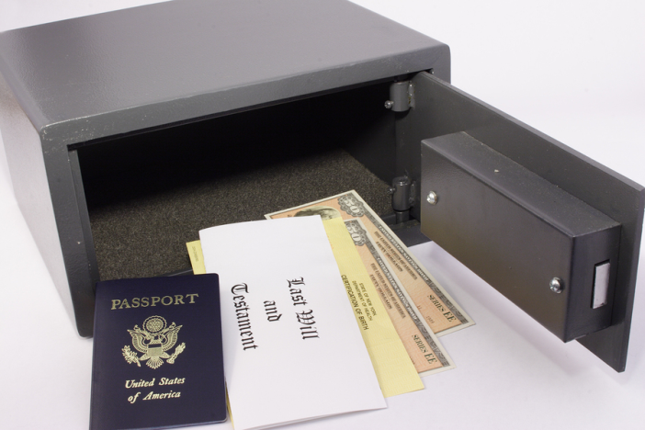
How can I protect my identity?
At home:
Keep your financial records, Social Security, and Medicare cards in a safe place.
Shred papers that have your personal or medical information.
Take mail out of your mailbox as soon as you can.
Notes:
At home, you should keep your financial records, social security information, and medical information in a safe place. Many people choose to place these documents in a safe or a lock box. It would be smart to invest in a shredder or a service that shreds papers for your personal or medical information that you are trying to get rid of. To decrease the chance of your mail being stolen, you should check your mailbox as soon as possible. It would be beneficial to know the time that the mail came daily and try to retrieve the mail then. It should be checked at least once a day.

Slide 10
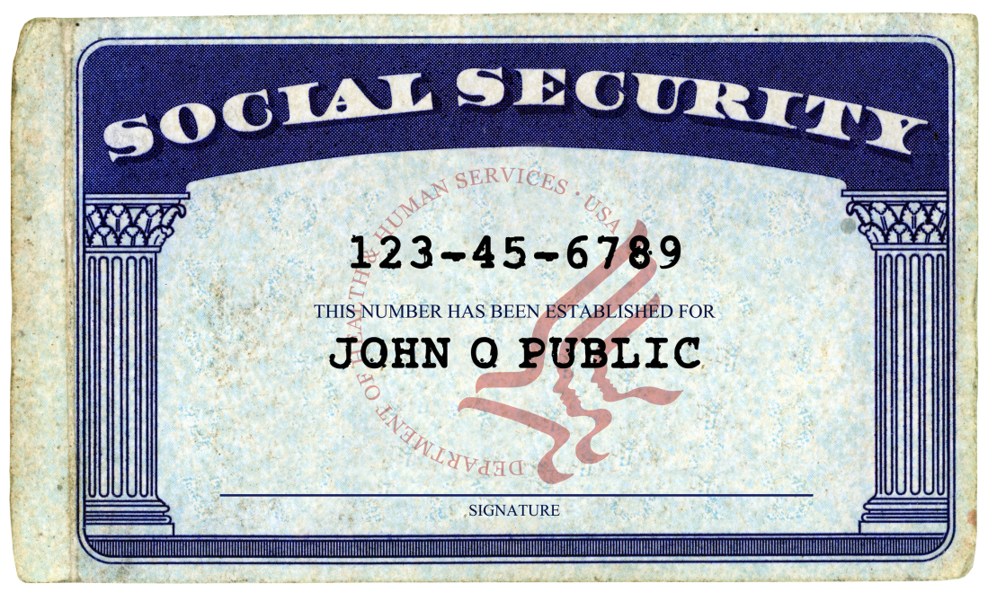
How can I protect my identity?
As you do business:
Only give your Social Security number if you must. Ask if you can use another kind of identification.
Do not give your personal information to someone who calls you or emails you.
Notes:
When you are doing business, only give your social security information when it is absolutely necessary. It is okay to ask if you can use any other form of identification. Never give your personal information to someone who calls or emails you. It is best to trade this information in person.

Slide 11
How can I protect my identity?
On the computer:
Use passwords that are not easy to guess. Use numbers and symbols when you can.
Do not respond to emails or other messages that ask for personal information.
Do not put personal information on a computer in a public place, like the library.
Shop on secure websites. They have an address that starts with “https”.
Have security software on your own computer.
Notes:
There are many precautions that you can take when you are on the computer. Always use passwords that are not easy to guess. When you can, include numbers and symbols. If you receive emails or messages that ask for personal information, do not respond. Never put your personal information on a computer that is in a public place such as a library. Only shop on secure websites. Usually secure websites begin with https. Note the s at the end. It could also be helpful to download or purchase security software for your computer.

Slide 12
Resources
http://www.credit.com/credit-reports/credit-reporting-agencies/
http://www.myfico.com/crediteducation/in-your-credit-report.aspx
http://www.justice.gov/criminal/fraud/websites/idquiz.html

