Slide 1
Basic Banking Services
This presentation will introduce students to the many features, background information, and provide an overview to the banking process and basic services provided to consumers.
Notes:
(DI- get a banker to come into)
Remove later)
Please make sure students are able to complete all of the activities and projects within this presentation.
These slides are derived from the Citigroup Financial Education Curriculum. For additional background and information, you may find the complete set of lessons at: http://curriculum.financialeducation.citigroup.com.
It is advised that you complete the following steps before you present any activity:
Review the Facilitator’s Guide of the Citigroup Financial Education Curriculum, which can be found on its CD-ROM or at http://curriculum.financialeducation.citigroup.com.
For information regarding online facilitator training, please contact fetraining@citigroup.com.
3. Review the materials thoroughly and be prepared with copies of the presentation or from the lesson. Determine for yourself whether or not you are truly comfortable presenting any activity. If you are not, you should ask for assistance, team teach with a colleague who is comfortable with the material, or teach a different lesson.
4. Each of the activities in this presentation may take up to 50-60 minutes.

Slide 2
Presentation Activities
Activity 1 Why Do You Need A Bank?
Activity 2 The Many Services of a Bank
Activity 3 Checking Accounts 101
Activity 4 Savings Accounts
Notes:
In this powerpoint, we will cover: why you need a bank in Activity 1, the many services of a bank in activity 2, Checking accounts in Activity 3, Maintaining a Checking Account in Activity 4, and Savings Accounts in Activity 5

Slide 3
Activity 1: Why Do You Need a Bank?
Overview:
Purposes of banks
The differences between banks and credit unions
Safety of financial institutions
Banks as money management tools
The Earned Income Tax Credit
‹#›
Notes:
Presentation opening
Teacher: Students, how many of you currently have some form of banking accounts
Open the discussion by asking for a show of hands of those who do any type of business with a bank.
• Be sure to remind everyone that the session is not about which bank (brand name) but rather, a bank.
• In some communities and with some age groups, people are cautious about providing personal information in a public gathering. If people don’t raise their hands, move on.
Tell participants that the purpose of this activity is to become aware of:
• Purposes of Banks
• Types of Financial Institutions
• Safety of Financial Institutions
• Privacy of Financial Institutions
• The ways that banks can help you manage your money
• The benefits of an Earned Income Tax Credit refund
Begin with the basic functions of a bank: to accept money in checking and savings accounts and to make loans.
• Encourage the participants to think in very general terms about the very basics of what banks do; specifics will be covered later.
• Stress that banks take in money and distribute money—through various services.

Slide 4
Purposes of a Bank
A bank is a financial institution which is involved in borrowing and lending money. Banks take customer deposits and pay back in interest.
Banks allow you to deposit, save and take loans.

Slide 5
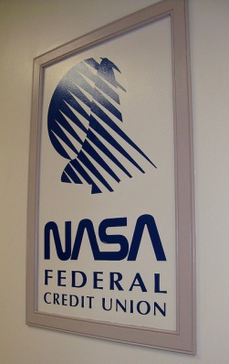
Banks vs. Credit Union
Similarities: both offer financial services (checking & savings accounts, Certificates of Deposit, loans, credit cards)
Credit Unions:
Nonprofit institutions that are member-focused.
Members pool money and that provides funds.
Owned and operated by members
Usually have higher interest rates
Smaller and have fewer services than banks

Slide 6
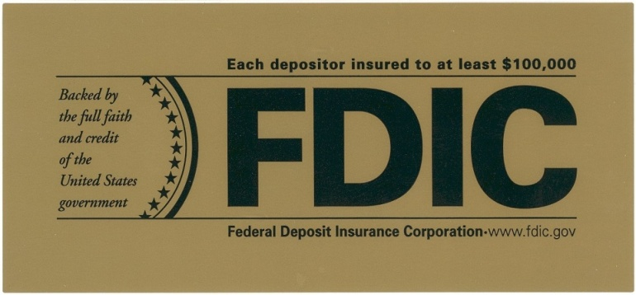
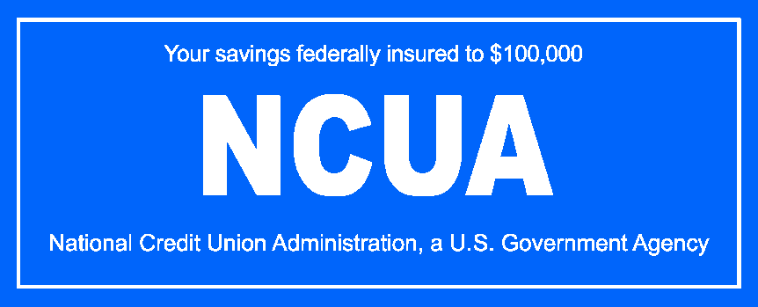
Safety of Financial Institutions
COMMERCIAL BANKS CREDIT UNIONS
Provides deposit insurance for up to $250,000, per depositor per bank
Backed by the full faith and credit clause
Provides insurance for federal credit unions
Backed by the full faith and credit clause
‹#›
Notes:
Emphasize that deposits in both banks and credit unions are safe. Both banks and credit unions insure most deposits up to $100,000 per depositor per institution.
Ask participants whether they think one type of financial institution is safer than another.
• Allow for responses, but be sure everyone recognizes that safety is very important to all bank officials. If people do not have confidence in the safety of banks, they will not do business with banks.
• Allow participants to discuss their concerns with safety in banks and related financial institutions. This is a major purpose of this financial education program—to build confidence in banks.
• Option: Consider one of two interactive options to use when discussing safety of financial institutions. If either option is used, remember to use the information as a review opportunity in closing the activity.
1. Private Option: Have each participant write on a slip of paper how confident they feel about financial institutions, on a scale of 1-5.
2. Public Option: Draw a line on the flipchart, board, or blank transparency. Divide into segments labeled 1-5. Label 1 = “least safe” and label 5 = “most safe.” Have participants individually mark the spot that illustrates how confident each one feels about financial institutions.
Use “Slide 1: Safety of Financial Institutions” to illustrate legal and regulatory oversight of financial institutions.
• FDIC: Federal Deposit Insurance Corporation
• NCUA: National Credit Union Administration
One final issue that participants may wonder about is privacy; how secure is the information they share with a bank? If the topic has not already come up, allow for a little discussion, then reassure participants that banks work to keep their information secure. Although policies vary, information is kept confidential. Encourage participants to ask questions about how this is done.

Slide 7
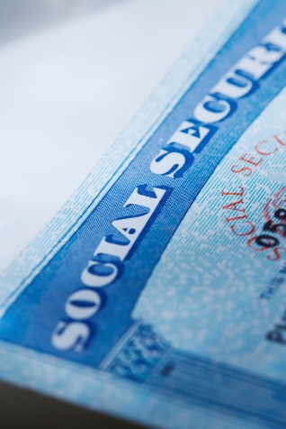
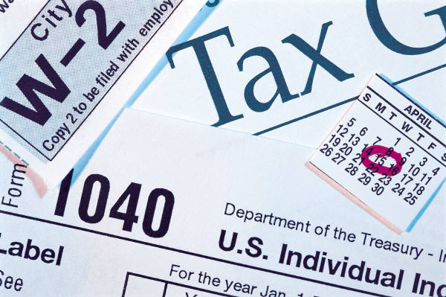
The Earned Income Tax Credit
The Earned Income Tax Credit (EITC)- a federal income tax credit for low-income workers. The credit reduces the amount of tax an individual owes, and may be returned to the taxpayer in the form of a refund.
Eligible workers must have:
1) Annual income and investment income that is below a certain level.
2) A Social Security Number
‹#›
Notes:
Write EITC on the flipchart. Ask whether anyone knows what EITC stands for. If no one responds, explain that the EITC is a tax credit for low-income workers and that many people use their refund to open a bank account.
Display “Slide 2: The Earned Income Tax Credit.” Discuss the eligibility requirements and the different suggestions of how to bank your EITC refund. Have participants list their own ideas for banking an EITC refund.
Ways to bank your EITC refund:
1. Start an emergency savings fund by opening a savings account.
2. Open a checking account so you can avoid paying check cashing fees and paying for money orders.
3. Save for the future by opening a Certificate of Deposit.
*EITC refunds will vary by applicant. For more information, consult a tax preparer or refer to the VITA, IDA, and CFED Resources in the Appendix.
The Earned Income Tax Credit (EITC)- a federal income tax credit for low-income workers. The credit reduces the amount of tax an individual owes, and may be returned to the taxpayer in the form of a refund. Some states offer additional forms of EITC.
Eligible workers must have an annual income and investment income that falls below a certain level. In tax year 2005, for example, if you are married, have two or more children, and are filing your taxes jointly, your combined annual income must not exceed $37,263. You must have a Social Security Number to receive the EITC.

Slide 8
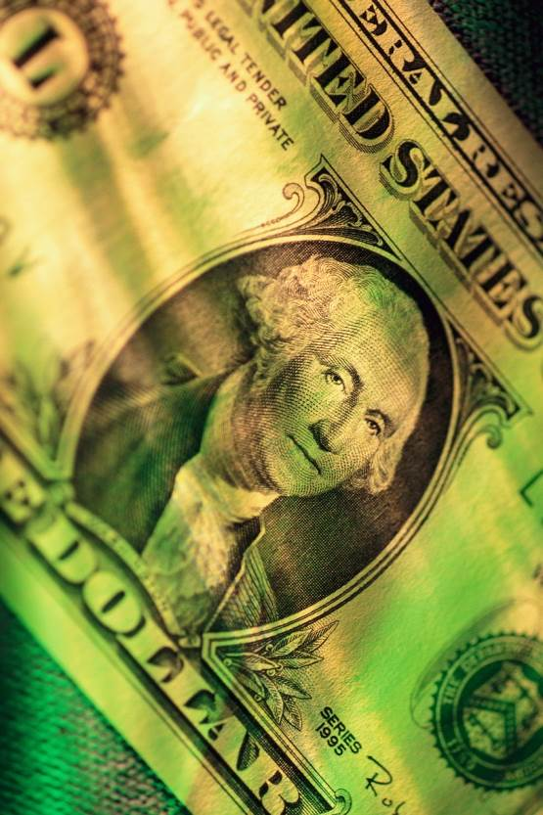
Activity 2: The Many Services of a Bank
Overview:
Financial services offered by a bank
Bank employees
Services that might be of personal benefit
Different types of transactional cards
The impact of state and federal regulations upon the security of a bank
‹#›
Notes:
Tell participants that the purpose of this activity is to become aware of the many services of a bank. Participants will learn to:
• Identify financial services provided by a bank, including electronic banking.
• Identify the bank employees who provide these services.
• Decide on services of personal benefit.
• Recognize the impact of state and federal regulations upon the security of a bank.
Begin the discussion by asking the participants to share the types of financial services they use at their local bank.
• Make a list of the responses on the flipchart, board, or blank transparency.
• This list does not need to be exhaustive, just an icebreaker for later group discussions.

Slide 9
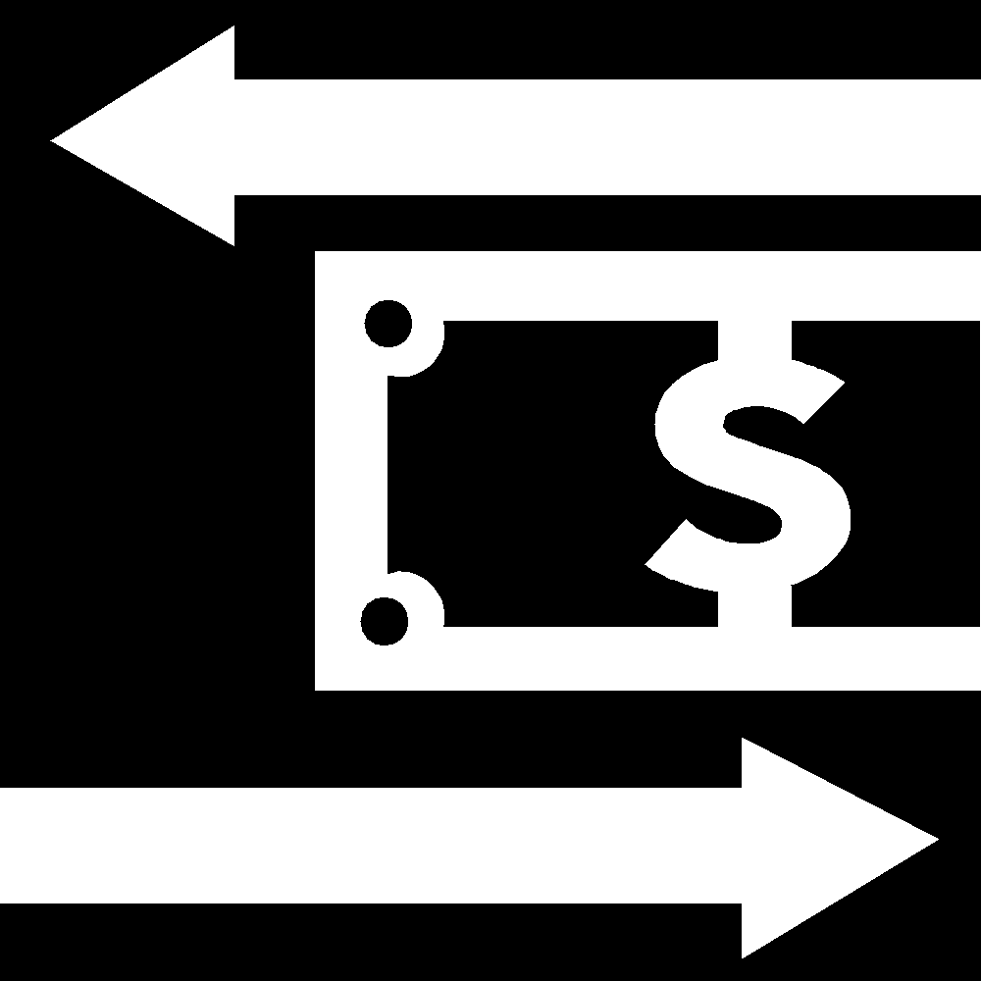
Options to Send & Receive Money
1. Money Transfer Organizations
2. Bank Transfers
3. Hand Delivery
4. Mail
5. Post Offices
6. Stored Value Cards
‹#›
Notes:
Remind participants that banks now offer a wide variety of services, many of them electronic in nature.
• Ask everyone to brainstorm with you about new types of electronic financial services provided by banks.
• Record the responses on a flipchart, board, or blank transparency. Inform participants that the next activity will focus on one specific financial service—remittances.
Display “Slide 1: Remittance Options to Send and Receive Money” to elaborate on the various ways people can send and receive money. Explain the importance of understanding the fees involved with the different methods, since costs may vary.
1. Money Transfer Organizations (MTOs)
MTOs, such as Western Union and MoneyGram, are licensed regional or global companies that offer cash transfers across borders. These services are available at agents within the local community, on the phone, or on the Internet.
2. Bank Transfers
Some banks and credit unions offer money transfer services from bank account to bank account and from bank account to cash, typically through a wire transfer or via check. The services are available via the bank branch, ATM, phone, and Internet. The money can be picked up at a local bank branch/agent or via a debit card through ATMs.
3. Hand Delivery
Some immigrants send money home through a courier, friends, or families returning to their home country for hand-delivery of the remittances.
4. Mail
Some immigrants send cash, money orders, or checks via the mail to their families in their home country.
5. Hawala
Hawala is an informal system, where an agent in the host country receives a certain amount and asks an agent in the destination country to give the corresponding amount in the local currency. The two agents will settle the debt through various mechanisms at a later time. This practice is common throughout South Asia.
6. Post Offices
Post offices throughout the world handle money transfers between countries. Countries in which post offices are used for remittance include the U.S., Mexico, many European countries, China, Israel, and Brazil.
7. Stored Value Cards
A stored-value card is a pre-paid account and is generally card-based. (The card can be used to transfer funds for payment, for example, to a merchant at a POS terminal, within the pre-paid balance of the account.)

Slide 10
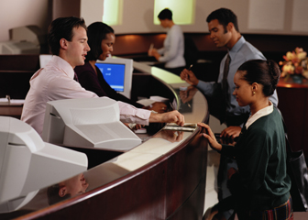
Bank Occupations
• Tellers
• Platform Bankers
• Mortgage Lenders
• Operations Managers
• Branch Managers
‹#›
Notes:
As participants learn about the different services that a bank provides, it will also be helpful for them to understand the various jobs functions of employees at bank branches. Help participants learn about the bank employees they may come into contact with by displaying “Slide 2: Bank Occupations.” Review each of the jobs listed on the slide.
Tellers:
The individuals who typically process financial transactions (Examples: deposits, withdrawals, payments) and help customers with service on their accounts. Tellers are also responsible for uncovering additional customer needs and referring customers to the appropriate sales person.
Platform Bankers:
The salespeople who offer financial product and service solutions. The platform banker opens bank accounts (Examples: checking and savings accounts) and credit products such as credit cards, home loans, and credit lines. If they have the proper licenses, they can also offer investment products such as mutual funds, or insurance products. After assessing a customer’s needs, these individuals may bring in additional specialists to help.
Mortgage Lenders:
Sales staff who specialize in helping customers finance their home purchases. Mortgage lenders help customers understand what home mortgage amounts they can afford by pre-qualifying them. They process mortgage applications and assist customers throughout the process of buying a home or refinancing their existing home. Some mortgage lenders specialize in certain segments of the market, such as first-time home buyers or properties in low-to-moderate income neighborhoods.
Operations Manager:
This person is typically responsible for the financial operations of a bank branch. While computers balance accounts, the operations manager reviews reports for any action that needs to take place. Some of their job responsibilities may include reviewing and making decisions on overdraft reports, reviewing teller transaction reports, ensuring that ATMs have money in them, and verifying teller balances at the end of the workday.
Branch Manager:
The person responsible for making sure the branch operates correctly from every level. The branch manager is responsible for hiring staff, ensuring the bank branch runs efficiently, meeting the needs of customers, and serving the needs of the community where the bank is located. Exact responsibilities vary from bank to bank, but the branch manager may also be responsible for bringing new business to the branch.

Slide 11
Electronic Banking Systems
Online banking is the fastest growing Internet activity in the United States
Types of Services:
Bank Cards
Automated Services
Protect Your Passwords!
Change passwords often and use different characters
Example: c3!in3-M?
‹#›
Notes:
Display “Slide 3: Electronic Bank Services.” As before, provide only a brief description of the electronic services. Control any extensive discussion.
Ask everyone to take one minute to think silently of all the advantages that electronic bank services provide today.
• Call time. Ask for responses; record them on the flipchart, board, or blank transparency.
• Responses may vary but should include such items as safety, convenience, and efficiency.
Protect Your Passwords
• Remember that your ATM, bank, or online passwords provide access to your accounts. Protect yourself from theft or fraud by choosing passwords that work for you, but no one else.
• Use unusual passwords. Combine numbers and letters, and avoid passwords that could be guessed easily, such as your birthdate or license number.
• Keep passwords secret, even from your small children. If you let them “help you” when you withdraw money from an ATM or use a debit card, keep them from seeing what password you use.
• Never give passwords or other key information to strangers via e-mail.
• Change passwords often.
• Use different passwords for different accounts.

Slide 12
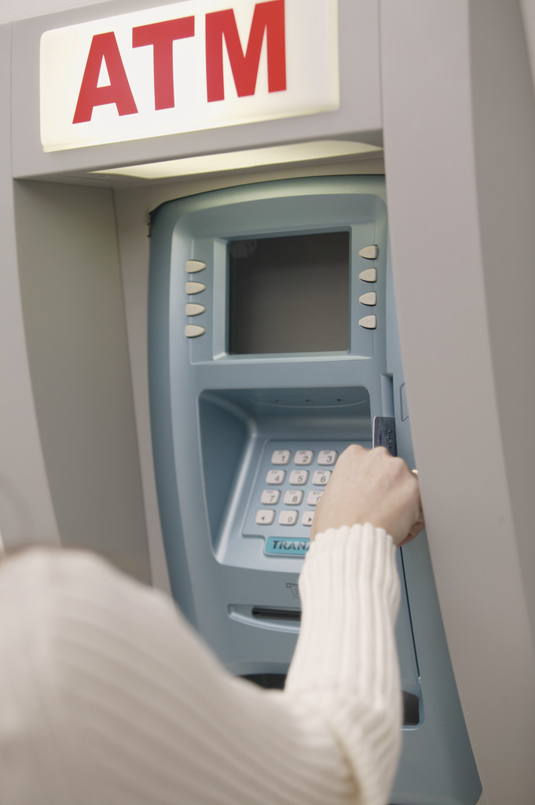
Electronic Banking Systems
• Direct Deposit
• Transfers between Accounts
• Transfers to a Third Party
• Online Banking
• Bank by Phone
• ATM
‹#›
Notes:
Review slide terms:
Direct Deposit
• Payments from third party into bank accounts for paychecks, Social Security, etc.
Transfers between Accounts
• Automatic transfer of money from one account to another, such as from a checking account to a savings account.
• Occur on a designated date of month.
Transfers to a Third Party
• Automatic payments of variety of bills directly from a bank account, such as automatically paying rent or monthly auto loan payment.
• Account holder receives confirmation.
Online Banking
• Requires computer and Internet access.
• Security = Username + Password.
• Available in real time.
• Allows customers to complete most regular bank transactions.
• Can be used to pay utility and other bills (bill payment).
Bank by Phone
• Provides electronic account access.
• Keypad or voice-activated.
• Requires a Personal Identification Number (PIN) or password access.
• Includes various options.
• Allows review of regular bank transactions.
• Allows one to speak to a bank customer service representative.
• Can be used to pay bills.
ATM
• Automated Teller Machine
• Allows one to obtain cash and conduct banking transactions.
• Allows regular review of bank transactions.
• Requires a Personal Identification Number (PIN).

Slide 13
Bank Card Types
ATM/ Debit Cards
Bank cards that allow for the payment of goods and services to be subtracted directly from a bank deposit account.
Credit Cards
Can be used with merchants that take major credit cards—known as point of sale (POS) transactions.
Variable interest rates
Stored Value Cards
Bank cards with preset, limited value.
Used to pay for goods and services.
Alternative to cash.
‹#›
Notes:
Use “Slide 4: Bank Card Types” and review Bank Card Types.

Slide 14
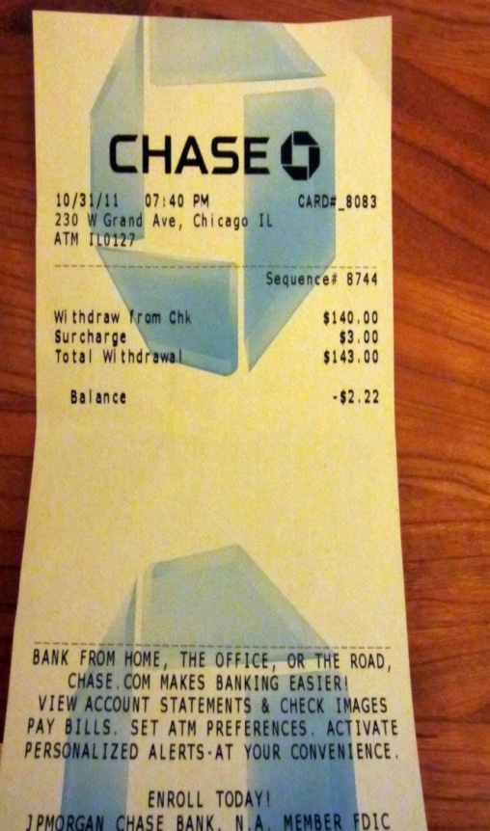
Regulation of Electronic Banking Services
Electronic Fund Transfer Act:
Protects consumers using any type of electronic
banking from loss and protects their privacy.
Banks must:
Offer customers a record or receipt for all computer transactions.
Investigate errors and report to customer within ten days of error notification.
Customers are responsible to report any errors.
‹#›
Notes:
Ask if anyone has concerns about the various electronic banking services
listed on Slide 3 and would be willing to share those concerns. This
discussion reflects on the main objective of this financial literacy program—
building confidence among individuals about banks. Take the time to listen to participants’ concerns, and try to respond in a positive manner.
• Option: As concerns are expressed, try to have fellow participants
provide peer input.
• When working with adult groups, stress the critical need for having
direct deposits for Social Security or other related checks.
Use “Slide 6: Regulation of Electronic Banking Services” as an
illustration to build confidence in the use of electronic services. Ask the
following questions:
• Were you aware that electronic services had such protection?
• Does such regulation make you more confident about using a bank’s
electronic services?

Slide 15
Activity 3:
Checking Accounts 101
Overview:
Purposes of a checking account
Shopping for and comparing checking accounts
‹#›
Notes:
Review the topics for discussion in this activity:
• Purposes of a Checking Account
• Shopping for a Checking Account
Begin the discussion by asking a volunteer to define the term “check.”
Support the responses, but be sure that the definition includes the fact that
A check is a written order telling the bank to pay a certain amount to another person or business.
Ask for a show of hands of those who have a checking account.
Ask participants why they use a checking account.
• Record the responses on a flipchart or blank transparency.
• Responses may vary but should include reasons such as convenience,
safety, easy access, etc.
Ask those participants who did not raise their hands why they do not use a
checking account.
• Don’t pressure individuals to respond.
• If there are no responses, encourage those who do not use a checking account to listen to the advantages and disadvantages of such a financial tool, and to consider using it in the future.

Slide 16
Checking Account Terms
Term | Definition
Bank Statement | A monthly statement of all the activity within an account that is provided by the bank.
Cancelled Check | A check that has been stamped to show that the payee has received the money, and the money has been deducted from the account holder’s account.
Check register/Ledger | A record of all activity that happens within a checking account maintained by the account holder.
Fee | Charges for the use of certain bank services
Interest | Money paid to holders of savings accounts and investors for the use of their saved or invested money.
‹#›
Notes:
Use “Slide 1: Checking Account Terms” to cover some basic terms about a checking account.
• Note that this slide can be used with multiple activities throughout this section.
• You may want to address these terms in an order that seems logical to you. You could do this by grouping all fees together, grouping together everything used in reconciling the register, etc.
Bank Statement: Monthly record of all activity within an account, provided by the bank.
Cancelled Check: A check that has been stamped to show that the payee has received the designated amount from the bank and that amount has been deducted from the account holder’s checking account.
Check: A written order to pay a specified sum from funds held in a bank or credit union account.
Check Register/Ledger: A record of all activity that happens within a checking
account; maintained by the checking account holder.
Endorsement: A written mark on the back of a check, such as a signature, entitling the payee to either receive or transfer payment.
Fee: Charges for the use of certain bank services. These services vary but could include returning cancelled checks, writing more than a certain number of checks monthly, use of various bank cards, etc.
Interest: Money paid to savers and investors by financial institutions, government, or business entities for the use of their money.
Minimum Balance: Requirement to keep a certain amount of money in the account; otherwise, monthly service charges may result.
Outstanding Transactions: Transactions that do not clear the bank by the date of the bank statement.
Overdraft: Lack of sufficient funds in a checking account to cover the full amount of a check. A bank or credit union will charge an Overdraft Fee — a service charge — to cover expenses involved in returning a check and handling other procedures caused by an overdraft.
Overdraft Protection: Procedure agreed upon by an account holder and a bank in
advance to transfer funds from a savings or credit account to a checking account to cover insufficient funds.
Payee: The person or organization to whom a check is made payable.
Reconciling a Bank Statement: Balancing a bank statement with a check register/ledger.
Transaction Limits: Some accounts have a limit on the number of transactions
performed during a certain time period. These may include the number of withdrawals, number of teller-assisted activities, etc.

Slide 17
Checking Account Terms
Term | Definition
Minimum balance | Requirement to keep a certain amount of money in the account; otherwise, monthly service charges may result
Outstanding transaction | Transactions that do not clear the bank by the date of the bank statement.
Overdraft protection | Procedure agreed upon by an account holder and a bank in advance to transfer funds from a savings or credit account to a checking account to cover insufficient funds.
Payee | The person or organization to whom a check is made payable.
Reconciling a Bank Statement | Balancing a bank statement with a check register/ledger.

Slide 18
Checking Account Terms
Term | Definition
Transaction limits | Some accounts have a limit on the number of transactions performed during a certain time period.
Endorsement | A written mark on the back of a check, such as a signature, entitling the payee to either receive or transfer payment.
Overdraft | Lack of sufficient funds in a checking account to cover the full amount of a check.
Check | A written order to pay a specified sum from funds held in a bank or credit union account.

Slide 19
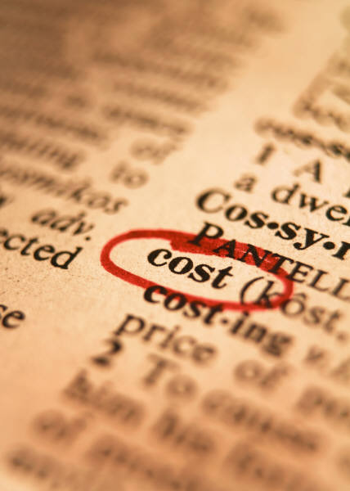
Shopping Around
SERVICES
Location of bank
Location of ATMs
Banking hours
Minimum balance required
Minimum transactions or limits
Interest-bearing accounts
Other
COSTS
Non-primary bank ATM transactions
In-branch transaction fees
Per-check fees
Other checking fees
Overdraft protection
Printing of checks
Things to ask about:
‹#›
Notes:
Ask if anyone looked for any special type of checking account when they opened their account. Record the responses. Responses will vary.
Help participants determine their banking needs by asking them to think about:
• How many checks they write monthly.
• Their typical checking account balance.
• What is convenient for them in terms of bank and ATM locations, hours, etc.
• What kind of accounts they want (non-interest vs. interest-bearing)
Use “Slide 2: Shopping Around” (Things to Ask About When Opening a Checking Account) to encourage participants to shop around for the checking account that fits their needs.
• Explain to participants the importance of shopping for a checking account. Go over some of the key features (Examples: the location, hours of operation, minimum balance required, etc.) that participants should compare before choosing a checking account. Tell participants to use slide 2 as a tool to help them evaluate the features of different checking accounts.
• Stress the value of key areas, especially if participants were looking for non-financial items such as color or style of checks.
• Remind participants that certain account features will help them save money. Some of the features to help participants save money and avoid bank fees include: 1) utilizing direct deposit to avoid check cashing fees; 2) avoiding non-primary ATM charges; and 3) keeping the minimum monthly account balance to avoid monthly maintenance fees.
• After the discussion, refer to the earlier responses about what participants looked for in a checking account.

Slide 20
Opening a Checking Account
Overview
Checking Account Application Process
The Application
Acceptable Forms of ID
The Signature Authorization Card
The PATRIOT Act
Writing a Check
‹#›
Notes:
Review the topics for discussion in this activity:
• Checking Account Application Process
• The Application
• Acceptable Forms of ID
• The Signature Authorization Card
• The PATRIOT Act

Slide 21
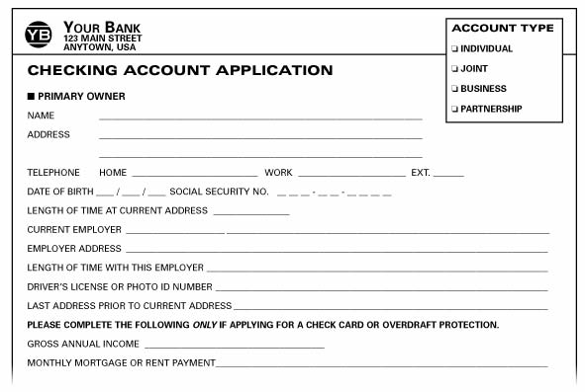
Opening a Checking Account
‹#›
Notes:
Opening a checking account is not difficult at all, you must go to the bank you would like to open the account. Do not go through the normal line, rather wait in the waiting area for an availed bank representative to call you (typically they take you to a desk or room). You must present valid ID, along with your social security number. You have to put down a deposit into the account within 25 days of opening the account, the amount required varies by bank. You have an option to have a debit card that is linked to this account. The following form is similar to one that you would fill out if you were opening a checking account.
Consider providing copies of this application handout, which can be found in the Citigroup Financial Education Curriculum:
“Basic Banking Services”, p. 44.
Use “Slide 1: Opening a Checking Account and “Slide 2: Commonly Accepted Forms of ID” to review with the participants the type of application they will probably see when opening a checking account.
• Move through the application, describing the various areas on the form.
• In reviewing the application, stress the need for accuracy and clarity
in all information.
• Emphasize that applicants must provide a physical address when their
mailing address is a post office box or similar postal receipt area.
The same information is asked of a joint applicant.

Slide 22
Commonly Accepted Forms of I.D..
Primary ID*
Photo Driver’s License issued within the U.S. or Canada
State Non-Driver Photo ID
Photo Learner’s Permit
Government Photo ID
U.S. Passport
Non-U.S. Passport
Resident Registration Card
Mexican Consular ID (Matricula Consular)
Naturalization Certificate
Employee Photo ID (from a recognizable employer)
Photo Trade License (barber, plumber, electrician, etc.)
Student Photo ID (college/trade school)
Medicare Card (must be 65 or older)
* Financial institutions' ID requirements may differ; check with the institution first before applying for an account.
‹#›
Notes:
A major topic to emphasize is proper identification. Although acceptable identification may vary among financial institutions, it always includes as least two types of current government-issued identification.
• Such regular identification might include a driver’s license, military ID,
passport, green card, etc. In some states, a Mexican consulate card is
an acceptable form of identification to open a bank account.
Review this slide and emphasize that this is a list of commonly accepted forms of primary ID, and that secondary ID is required (reviewed on next slide).

Slide 23
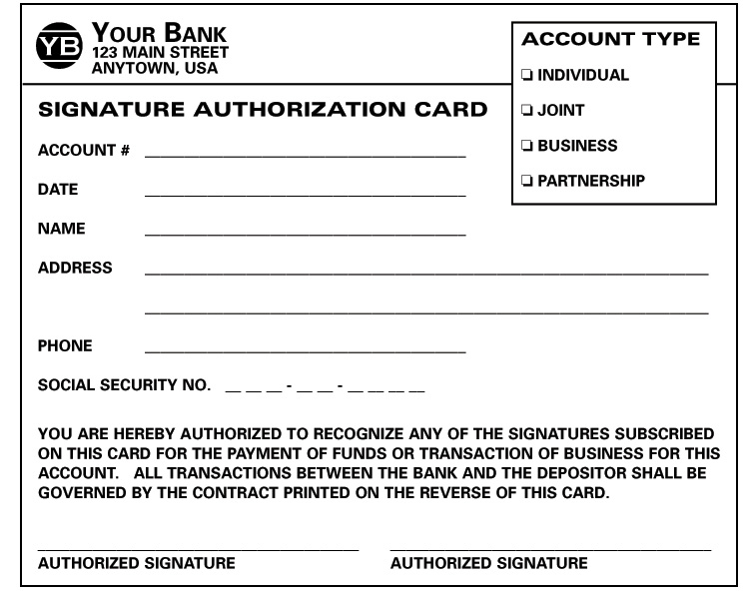
Signature Authorization Cards
‹#›
Notes:
Use “Slide 5: Signature Authorization Card” to review and describe
the areas on the card. Explain the purpose of the signature authorization
card and how the bank uses it to help safeguard customers’ money.
Ask those who have a checking account how they make their deposits.
Responses may vary, but should include depositing the funds at the bank,
through the mail, at an ATM, and direct deposit.
Encourage participants to consider the option of direct deposit.
• Ask if anyone uses the option. If so, have them explain.
• Suggest that they contact their local banker to learn more about setting up direct deposits.
Ask what might be the advantages of using direct deposit. Responses may
vary but should include safety and convenience.

Slide 24
The Patriot Act
Congress passed the PATRIOT Act in response to the terrorist attacks of September 11, 2001. Financial institutions are now required to collect certain information when a new account is opened.
1. The customer must provide identification that includes name, date of birth, address, and identification number.
2. The institution must maintain a copy of the information used to verify the person’s identity.
3. The institution must determine whether the applicant appears on the lists of known or suspected terrorists or terrorist organizations.
‹#›
Notes:
Display “Slide 4: The PATRIOT Act.” Explain what the PATRIOT Act is and why it was created. Walk through the points on the slide, explaining what types of information financial institutions are now required to collect when a customer opens an account.
There are often misconceptions about the PATRIOT Act.
• Some believe that the PATRIOT Act prohibits banks from opening accounts for people without a Social Security number. Explain to participants that many institutions accept a range of documents as outlined in slide 2; it may not be necessary to have a Social Security number to open an account.
• Another common myth is that undocumented immigrants can’t obtain legitimate credit or build a credit history. This is untrue. A growing number of financial institutions accept alternatives to the Social Security number to issue credit cards or loans. Additionally, lenders may report the borrower’s repayment information to the major credit reporting agencies using the Individual Taxpayer Identification Number (ITIN).
This law was enacted to fight terrorism; it will not impact the safety of your money. Be assured that the money you deposit in a bank is safe; it is insured up to $100,000 per depositor by the Federal Deposit Insurance Corporation.

Slide 25
Writing a Check
Check Number & Transit Number
Amount in Words
Date
Amount in Number
Payee
Memo
Signature Line
‹#›
Notes:
Consider providing copies of this handout, which can be found in the Citigroup Financial Education Curriculum:
“Basic Banking Services”, p. 51.
Display “Slide 1: Writing a Check.”
• Stress that actual checks should always be written in ink.
• Talk about the process of voiding checks when one makes a mistake using a pen.
• For Spanish-speaking students, refer to the table on page 15 in the Appendix for writing numbers in English.
• Include an explanation of routing, check, and account numbers listed on the check.
DATE: Include the month, day, and year you are writing the check.
PAYEE: Write the name of the person or business on the line, “Pay to the order of.”
AMOUNT IN NUMBERS: Write the amount of the check in numbers. Begin close to the left of the section to prevent anyone from adding additional numbers.
AMOUNT IN WORDS: Write the amount of the check in words.
SIGNATURE: Sign all checks the way you sign the signature card.
MEMO: Use to note the reason for the check. If you are paying a bill, you can also use this space to supply information requested by the company.
ROUTING NUMBER: The nine-digit string of numbers used to identify your bank to process the transaction.
ACCOUNT NUMBER: The number used to identify your unique account within a bank.
CHECK NUMBER: The number used to identify a specific check within the sequence of the register. Usually three or four digits.
TRANSIT NUMBER: The hyphenated number in the upper right-hand corner that is above or to the left of a second number, separated by a line or slash; used to list checks for deposit.
• Stop frequently and ask if there are any questions. Don’t move forward until you are sure everyone understands the sample check.

Slide 26
Maintaining a Checking Account
Overview:
Check 21
Keeping a check register
Making a deposit into a checking account
Reconciling a bank statement
Maintaining a checking account
Avoiding Overdrafts
‹#›
Notes:
Consider providing copies of this entire activity, which can be found in the Citigroup Financial Education Curriculum:
“Basic Banking Services”, pp. 58-67.
Review the topics for discussion in this activity:
• Check 21
• Keeping a Check Register/Ledger
• Making a Deposit
• Check Endorsement Process
• Deposit Slip Procedure
• Reconciling a Bank Statement
• Avoiding Overdrafts

Slide 27
Check 21
Check 21- a federal law that helps banks handle more checks electronically and that makes check processing faster and more efficient.
Under this law, a check deposited in a bank is typically “delivered” overnight to the paying bank and deducted from the check writer’s account on the next business day.
Money may be deducted from your checking account almost immediately.
‹#›
Notes:
Write the term “Check 21” on the flipchart. Ask participants whether they
know what Check 21 is and how it affects them. Allow a few minutes of
discussion, and then display “Slide 1: Check 21.” Walk participants
through the points of the slide.
How does Check 21 work?
• Instead of physically moving paper checks from one bank to another, Check 21 allows banks to process more checks electronically.
• Banks capture a picture of the front and back of the check along with the associated payment information and transmit this information electronically.
• This process enables banks to reduce the cost of physically handling and transporting original paper checks, which can be very expensive.
How does Check 21 affect me?
• Under this law, a check deposited in a bank is typically “delivered”
overnight to the paying bank and deducted from the checkwriter’s account on the next business day.
• Money may be deducted from your checking account almost immediately.
• Before you write a check, it’s always best to make sure your checking account has enough money in it to cover the check.
Once participants understand the impact of Check 21, they will realize how
important it is to maintain a balanced checking account to ensure that they
always have money in their account when they write checks.

Slide 28
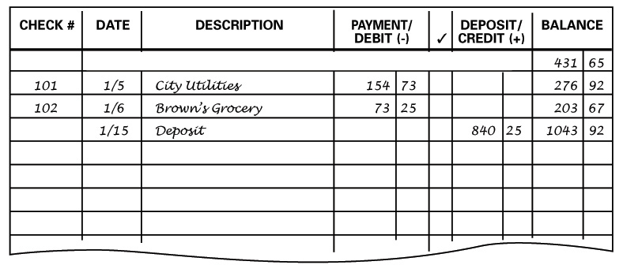
Keeping a Check Register
‹#›
Notes:
Cover the “Check Register” segment.
• Review column headings with a brief explanation. Note that the ✓
column is for checking when a transition has appeared on a bank
statement.
• Be sure everyone understands the importance of accurately recording
all activity involving the checking account. Explain what happens if a
check bounces and how expensive that can be.

Slide 29
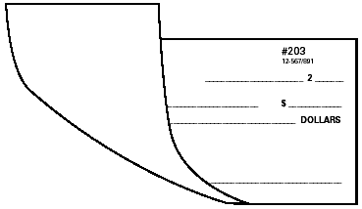
Making a Deposit: Endorsing a Check
The Back Side of a Check
Restrictive Endorsement
(most secure)
Blank Endorsement (least secure)
Endorsement to a third party
‹#›
Notes:
Cover the “Making a Deposit” segment.
• Begin the check endorsement process by reviewing the completed samples.
• Make sure the participants understand the three types of endorsement AND the advantages of each.
Restrictive Endorsement (most secure)
Limits what can be done with the check. If you include “For Deposit Only,” no one can cash the check; it must be deposited into your account (checking or savings).
Blank Endorsement (least secure)
Include only your name. Makes the check payable to anyone.
Endorsement to a Third Party
Limits payment to a third party. You are “signing the check over” to someone else.

Slide 30
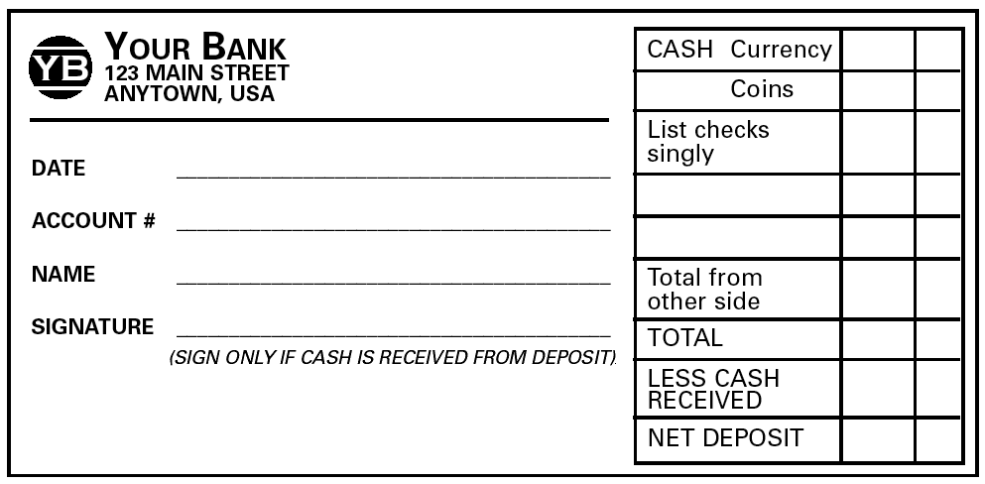
Making a Deposit: Completing a Deposit Slip
‹#›
Notes:
Move to the process of making a deposit.
(a) Date of deposit.
(b) Amount of paper money being deposited.
(c) Amount of coins being deposited.
(d) Transit number of check being deposited; the hyphenated number in the upper right-hand corner of a check that is above or to the left of a second number, separated by a line or slash.
(e) Amount of check for deposit.
(f) Total from other side of the slip.
(g) Total amount of deposit.
(h) Any amount of the deposit that you want returned to you in cash.
(i) Sign if you receive cash from the deposit.
(j) Total amount of deposit (less cash).
Deposits can be made in a branch or through the ATM.

Slide 31
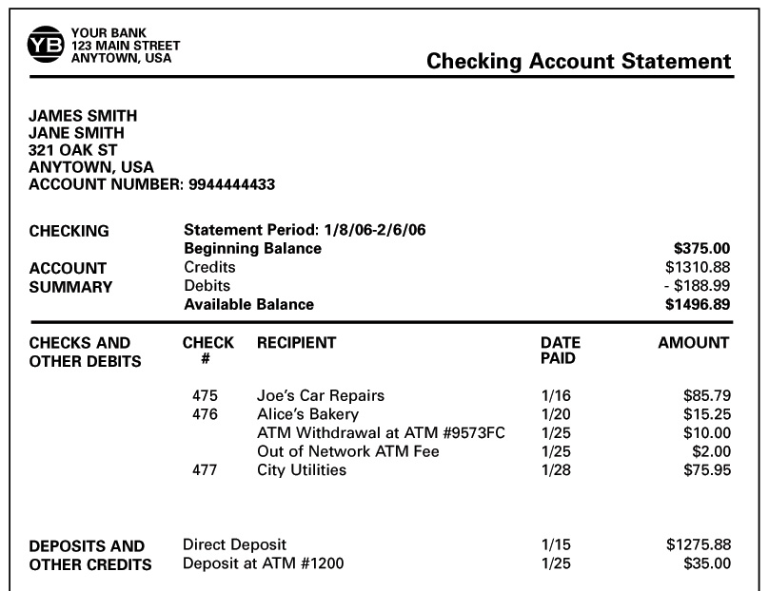
Reconciling a Banking Statement
‹#›
Notes:
Cover the “Bank Statement” segment.
• Begin by covering the completed bank statement, reviewing each area of the statement. Point out that a register must be reconciled for all fees and charges on a statement.
• Explain what to do when the balances are not equal; list potential things to check (calculations, entry of numbers, etc.)

Slide 32
Overdrafts and Bounced Checks
Overdrafts and bounced checks occur when you complete a financial transaction (e.g., write a check) for more than what is available in the account.
Your financial institution may pay the amount and charge you a fee, known as an “overdraft fee” or a “nonsufficient funds fee.”
Tip: Avoid overdraft or non-sufficient funds fees by making a habit of monitoring the balance in your checking account.
‹#›
Notes:
Display “Slide 6: Overdrafts and Bounced Checks.” Discuss this
slide, emphasizing the importance of maintaining a checking account in
order to avoid fees and the possibility of the bank or credit union closing the account. This could make it difficult to open another account in the future.
Example:
A $10 check made out to a grocery store bounces and a $30 overdraft fee is charged to cover the cost of the check. The total for the amount of the check plus the fee is $40.

Slide 33
Activity 4:
Savings Accounts
Overview:
Purpose of a savings account
Shopping for a savings account
Applying for a savings account
Monthly bank statement checkup
‹#›
Notes:
Review the topics for discussion in this activity:
• Purpose of a Savings Account
• Shopping for a Savings Account
• Savings Account Application
• Monthly Bank Statement Checkup
Using the flipchart or a blank transparency, ask the participants to share why they save. Write down their reasons. Responses will vary.

Slide 34
Reasons to Save
Emergencies
Future Purchases
Future Investments
‹#›
Notes:
Use “Slide 1: Reasons to Save” to summarize the specific reasons that individuals have just provided.
• Refer to the class list. Ask participants to work with you to classify each of their reasons under one of the slide’s headings.
• Be sure everyone understands that saving means not spending — putting aside some amount of current income for future use.
Move forward by asking participants to help you brainstorm different places
where people keep their savings.
• Record the responses. These may include places such as a box, sock,
bottom of a drawer, etc.
• Remind everyone that when saving, people hope that small amounts will grow to a much larger amount.
• Refer to the previously brainstormed list of places where people save and ask the participants to choose which of the areas represent places where their money will actually grow to a larger amount.
• This should be a simple process of showing individuals that saving in a sock or some other hiding place at home does not allow their money to grow.
Remind everyone that one of the simplest ways to save is to have a savings
account at a local bank or other financial institution.

Slide 35
Shopping for a Savings Account
Factors to consider:
Safety
Risk
Minimum Account Balance Requirements
Fees and Service Charges
Interest Rate
Returns (Earnings)
Automatic Transfer
Direct Deposit
‹#›
Notes:
Ask if anyone can tell why a person should save his or her money in a
savings account. These responses should open the discussion for the next
segment on shopping for a savings account.
Ask for a show of hands of participants who have a savings account. If
individuals do not raise their hands, don’t pursue.
Use the flipchart, board, or blank transparency to ask participants what they are looking for when they go “shopping” for a savings account. Record the responses.
Use “Slide 2: Shopping for a Savings Account” to summarize their
earlier individual brainstorming responses. Provide a brief description of each item on the slide. (See Glossary for definitions.)

Slide 36
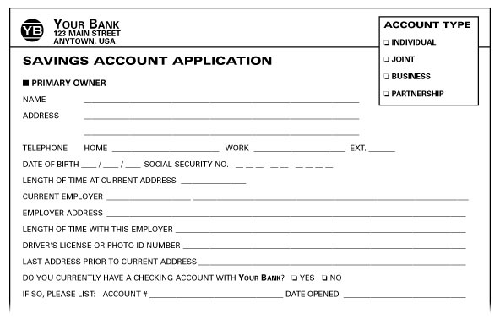
Opening a Savings Account
‹#›
Notes:
Consider providing copies of this application handout that can be found in the Citigroup Financial Education Curriculum:
“Basic Banking Services”, p. 74.
Use “Slide 3: Opening a Savings Account” to review with participants the type of application they will probably see when opening a savings account.
• In reviewing the application, stress the need for accuracy and clarity in all information.
• Emphasize that applicants must provide a physical address when their mailing address is a post office box or similar postal receipt area.
• A major emphasis to cover is proper identification. Although acceptable identification may vary slightly among financial institutions, it always includes as least two types of current government-issued identification.
• Such regular identification might include driver’s licenses, military IDs,
passports, green cards, etc. In some states, a Mexican consulate card is an acceptable form of identification to open a bank account.
• Be prepared. Check with the bank to learn what you will need to open an account and when the bank is open.
• Remind participants that just as they would balance their checking accounts, it is similarly important to balance their savings accounts.

Slide 37
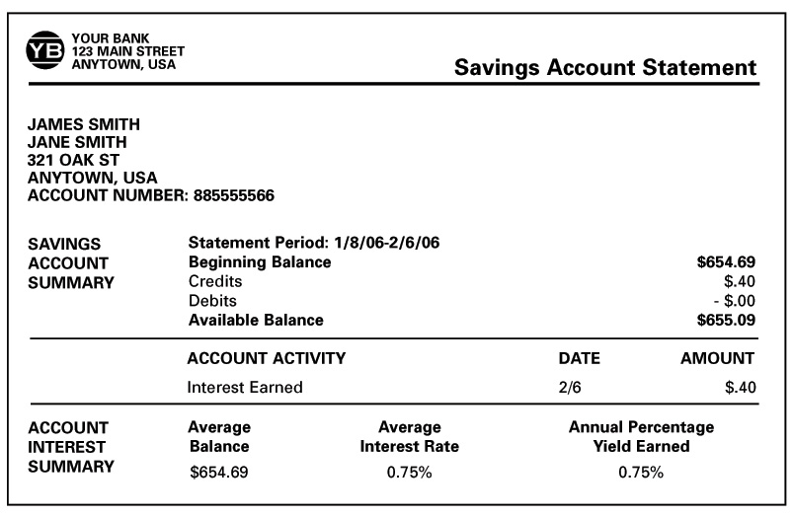
Bank Statements
‹#›
Notes:
Ask for reasons why balancing a savings account monthly would be
important.
• Record the responses.
• In essence, participants should realize that maintaining oversight of any financial document is critical and that errors should be corrected immediately with their financial institutions.
Use “Slide 4: Bank Statement” to review with participants where they should look on their bank statements to check the status of their savings accounts.
Note that some banks use “combined statements” if the account holder has
more than one account at the same bank.
Thank everyone for their participation, and encourage them to return for
additional sessions. If such sessions are scheduled, you might provide a
“sneak preview” of any activity to come.

Slide 38
In Summary…
Activity 1 Why Do You Need A Bank?
Activity 2 The Many Services of a Bank
Activity 3 Checking Accounts 101
Activity 4 Savings Accounts
‹#›
Notes:
Ask for reasons why balancing a savings account monthly would be
important.
• Record the responses.
• In essence, participants should realize that maintaining oversight of any financial document is critical and that errors should be corrected immediately with their financial institutions.
Use “Slide 4: Bank Statement” to review with participants where they should look on their bank statements to check the status of their savings accounts.
Note that some banks use “combined statements” if the account holder has
more than one account at the same bank.
Thank everyone for their participation, and encourage them to return for
additional sessions. If such sessions are scheduled, you might provide a
“sneak preview” of any activity to come.

