Slide 1
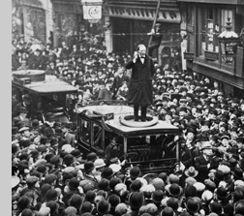
Verbal and Non-verbal Communication

Slide 2
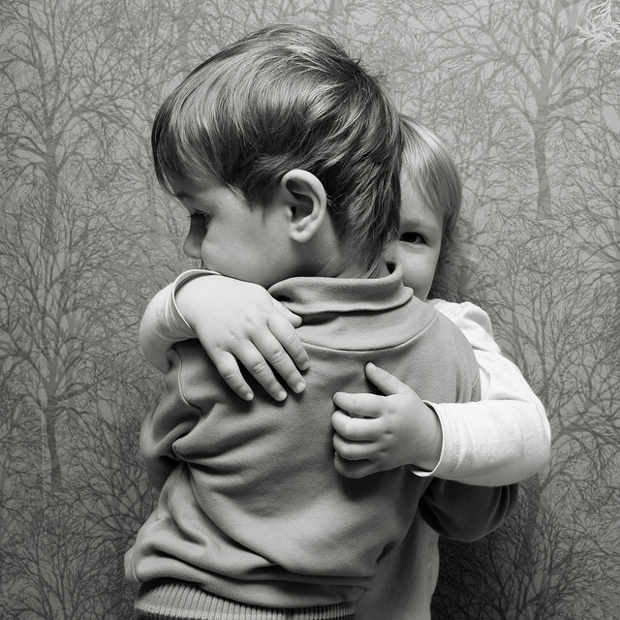
Communication
Communication allows us to connect to other people
Communication is a combination of verbal and non-verbal skills.

Slide 3
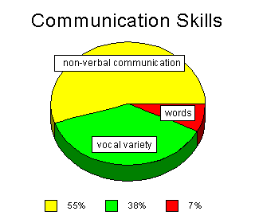
Communication Skills
Really!?
Notes:
WHY? Are most of our communications non-verbal

Slide 4
The Importance of Verbal Communication
Being able to verbally communicate well allows you to
Express your ideas / opinions vocally
Speak to other / audiences
Negotiate
Give great speeches
Influence people

Slide 5
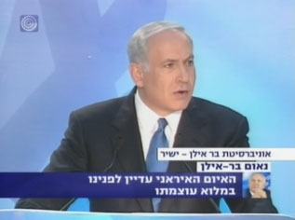
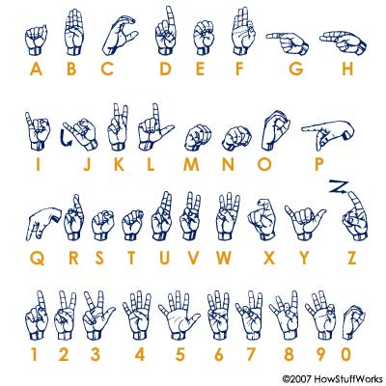
Verbal Communication
A way for people to communicate face-to-face.
Some of the key components of verbal communication are sound, words, speaking, and language.
Sign language is considered a verbal language because it is made up of words & expressions

Slide 6
Register
Register-the formality with which you speak based on social positions and relations.
For example: Greetings
“What’s up” - to a friend
“Good Morning” - to your boss

Slide 7
Non-Verbal Communication
Facial Expressions
Body Language
Eye Contact
Dress and Physical Appearance
Gestures
Silence

Slide 8
The Importance of Non-Verbal Communication
Non-verbal communication is JUST as important as verbal communication
When your nonverbal signals match up with words you’re saying →increase trust, clarity, and rapport.
When nonverbal signals do not match up with words that you’re saying → generate tension, mistrust, misunderstanding and confusion.
Have a Great Day!

Slide 9
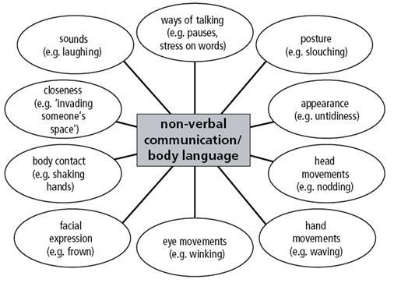

Slide 10
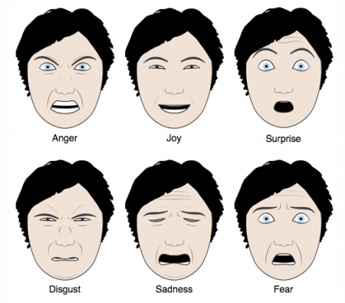
The Six Common Faces
Different cultures have different nonverbal signals but these six emotions can be read across cultures

