Slide 1
Money and Financial Institutions
Introduction to Business and Technology

Slide 2
Standard
BMA-IBT-9
Develop effective money management strategies and understand the role and functions of financial institutions.

Slide 3
The Main Idea
Money functions as a standard of value, a medium of exchange on payment and a store of value.

Slide 4
Vocabulary Terms
Money
Monetary System
Financial Institution
Bank Account
Deposit
Withdrawal
Interest
Electronic funds transfer (EFT)
Direct deposit
Collateral
Mortgage
Safe deposit box

Slide 5
Academic Vocabulary
Acquire
Stable
Primary
Secure

Slide 6
Vocabulary - Key Terms
Is a standard of value and means of exchange or payment.
Money
A system in which goods and services are exchanged using money.
Monetary system

Slide 7
Vocabulary - Key Terms
Financial institution
A firm that manages money.
Is a record of the amount of money a customer has deposited into or withdrawn from a bank.
Bank Account

Slide 8
Vocabulary - Key Terms
Electronic Funds Transfer (EFT)
Money that is transferred from one bank account to another through a network of computers.
Electronic transfer of a payment directly from the payer’s bank account to that of the person being paid.
Direct Deposit

Slide 9
Key Terms
Property or goods pledged by a business to use as security against a loan if the loan is not paid back.
Collateral
An agreement in which a borrower gives a lender the right to take the property if the loan is not repaid.
Mortgage

Slide 10
Key Terms
A secure box in bank’s vault used for the safe storage of a customer’s valuables.
Safe-deposit box

Slide 11
The Purpose of Money
Money enables people and
businesses to buy
and sell goods and
services more easily.

Slide 12
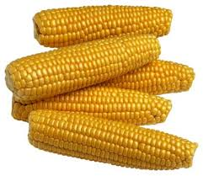
In the Past, People Used Anything For Money
Shells
Rocks
Corn

Slide 13
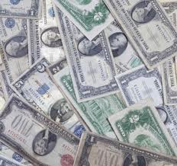
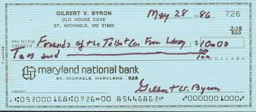
Money Is Most Commonly Considered To Be…
Coins
Currency
Checks

Slide 14
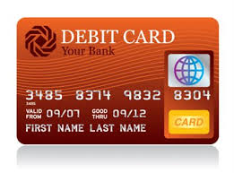
Modern Society Uses Coins, Currency, Checks and Debit Cards

Slide 15
Money Has Three Basic Functions:
Medium of
Exchange
Standard of
Value
Store of
Value

Slide 16
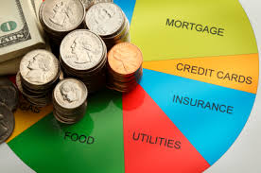
A Medium of Exchange
Medium of Exchange is anything that is accepted as a measure of value and of wealth. In a system that uses money, buyers and sellers agree to exchange money.

Slide 17
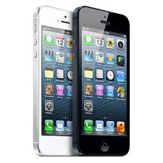
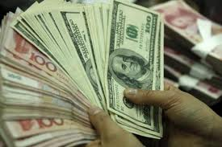
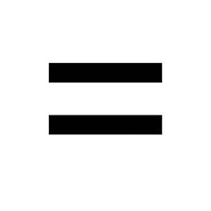
Standard of Value
A Standard of Value is a way of measuring
the weight, amount, size and value of something. Money provides a means of measuring the value of goods and services.

Slide 18
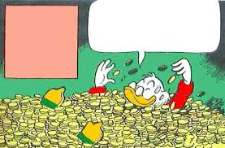
Store of Value
The Store of Value means money holds its value overtime and can be stored or saved.
Money that is saved is called wealth.

Slide 19
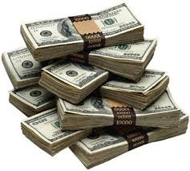
Characteristics of Money
Paper money and coins are common forms of money.
For money to carry out its function, it must have the following six characteristics.

Slide 20
Characteritics of Money
Scarce
Portable
Durable
Divisible
Acceptable
Hard to Counterfeit
Money

Slide 21
Characteristics of Money
Money must be stable in value. Money that is stable has little if any change in value.
To be used as money, an item must be scarce. If the supply of an item is overly plentiful, it loses its value and cannot serve as money.
Example: In America, diamonds are scare that is why they can be exchanged for money.

Slide 22
Characteristics of Money
Money must be acceptable. People must be willing to take money in exchange for goods and services.
Money should be divisible into parts.
Money has to be portable and durable.
Money must be hard to counterfeit (to make a copy to defraud or deceive people).

Slide 23
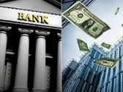
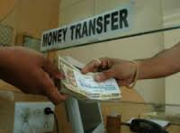
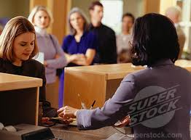
The Functions of Banks
Store Money
Transfer Money
Lend Money

Slide 24
Storing Money
One of the main services banks provide is storing money in bank accounts.
To store money means to place or leave it for preservation or later use.
An advantage to storing your money in a bank is it prevents you from losing it, spending it or having it stolen easily.

Slide 25
Bank Accounts
The two main types of bank accounts are
checking and saving accounts.
Checking Accounts
Used for storing money for a short period of time
Banks usually charge a fee
Savings Accounts
Used for storing money over a long period of time.
Banks usually pay interest
An advantage to having a savings account is that it earns more interest than most checking accounts for keeping money.

Slide 26
Transferring Money
Banks use check and electronic funds transfers to move money.
Checks are mainly used to transfer money from one person to another.
Banks use electronic funds transfers and direct deposits.
Many employers issue payroll check by direct deposit.

Slide 27
Lending Money And How Banks Make A Profit
Lending money is the primary way that banks make money.
The money you deposit in a bank makes it possible for the bank to lend money to other customers.
Banks pay customers interest on their savings
Customers pay interest on the money they borrow from banks
Banks use the interest they earn to pay interest on customers’ saving accounts.

Slide 28
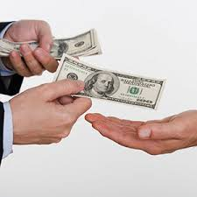
Collateral
Most Bank Loans Require Some Form Of Collateral
Put up your house as collateral and we will give you a loan .

Slide 29
Four Main Types Of Bank Loans
Mortgage Loan
Used to buy real estate
Commercial Loan
Used by businesses to buy supplies and equipment
Individual Loan
Made to an individual to pay for car, vacation, home repairs.
Line of Credit
Specific amount of money to be used at any time for any purpose.

Slide 30
Other Financial Services
Advice on Managing and Investing Money
Safe-Deposit Boxes
Debit Cards
Credit Cards

Slide 31
The Barter System
Suppose you wanted to trade some tomatoes for sneakers.
In the barter system, you would have to find someone willing to accept tomatoes for sneakers.
Finding someone willing to accept what you want to trade for what they want to trade.
You would also have a hard time figuring out the value of what you wanted to trade.

Slide 32
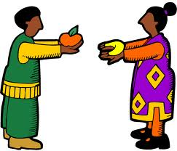
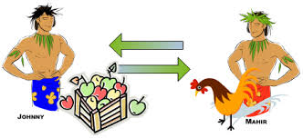
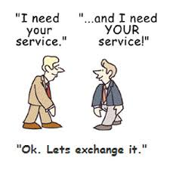
The Barter System
The Barter System is still used in some businesses situations. More than 100,000 businesses have been involved in bartering.

Slide 33
Review

Slide 34
Ticket Out The Door
Most employers today issue payroll check by using _____________ _________ ___________.

