Slide 1

Professional Image
Dr. Lajuan Davis
Associate Professor
University of Wisconsin-Whitewater

Slide 2

Start at the Beginning . . . .
A good handshake is worth a thousand words.
  Make a good first impression
    Three – five seconds
  No wimpy handshakes!
  Remember people’s names.
  Know your audience!

Slide 3

“Conservative” Is the Key
Research states that company dress is moving back to “conservative” business attire and away from business casual “confusion.”
Company executives want to envision you as one of “them.”
Theme: what
you can do for
a company . . . .

Slide 4

Business Attire for Men
Suits: two- or three-piece > three-button suits are preferred (light wool content); earth colors
Jewelry: watch, rings (wedding ring and/or class ring), no earrings
Conservative is the key . . . .

Slide 5

Business Attire for Business Professionals
The “nos” ---
No long hair: short, clean, well-groomed
No facial hair (men)
No piercings on face or head
No tattoos (court rulings)
No long fingernails
No overpowering cologne
or perfume

Slide 6

Business Casual Dress Defined for Business Professionals
Khakis (starched and pressed)
Polo shirt or collared, button-down shirt
Sport coat, sweater, blazer
No sandals
A black blazer will hide a
multitude of sins!

Slide 7

Tips for Success
“Overdress” for business occasions.
Call someone you know to determine proper attire.
Watch your posture!
Note: business casual
is not blue jeans,
sweat suits, flip-flops,
or sneakers.

Slide 8
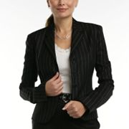
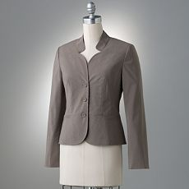
Business Attire for Women
Suits: skirts for interviews; slacks or skirts for everyday wear (light wool content); earth colors
Shirts: crisp, clean (light colors for interviews), button-down or scoop neck

Slide 9
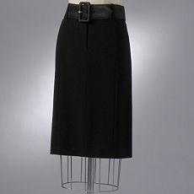
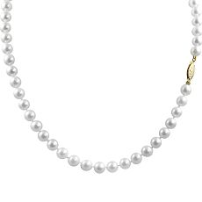
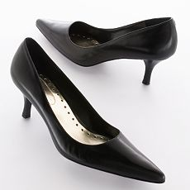
Business Attire for Women—cont’d.
Shoes: leather (no toes showing for interviews!); pumps or sling-backs with skirts; loafers with slacks
Pantyhose must be worn with skirts (sorry!)

Slide 10


Business Attire for Women Cont’d . . .
Jewelry: watch, rings (wedding ring and/or class ring)
Rule of thumb: wear real jewelry > pearls preferred for interview and more formal business occasions; no “noisy” or costume jewelry
Neutral make-up

Slide 11

More Business Attire for Women
The “nos” ---
No long hair in face: short, clean, well-groomed or pull hair up or back from face
  Change hair style every five years.
  Style hair in 10 minutes or less.
  Do not use “scrunchies,” pigtails,
    or ponytails.

Slide 12






Business Casual Examples

Slide 13

Professional Résumé Creation
A résumé is a roadmap of your life and should be handled delicately and professionally.
Length: 1 ½ -- 2 pages
State important facts.
Leave something to talk
about in the interview.

Slide 14
Professional Résumé Creation
Proofread to have no errors!
Include whitespace.
  Minimum of 1” margins
Use 12-point font.
Use proper fonts with no colors.
  Times New Roman
  Tahoma
  Century Gothic

Slide 15
Résumés continued . . .
Start with educational information.
  Be sure to put the name of the university, degree,
    graduation date in bold or italics.
No high school information!
Be sure to include
  Study abroad/internships
  Scholarships
  Outstanding achievements

Slide 16

Résumés continued . . .
Follow educational information with experience.
  Use functional format to highlight “skill sets.”
  Use action verbs to describe job duties.
Be sure to include
  Internships
  Part-time jobs
  Outstanding achievements

Slide 17

Résumés continued . . .
Follow work experience with co-curricular or extracurricular activities.
  Co-curricular: “With” the curriculum
  Extracurricular: “Outside” curricular requirements
  Use “reverse chronological” order.
  Use action verbs to describe duties.
Be sure to include volunteer
experience.

Slide 18
Résumés continued . . .
Revise résumé for each job.
Look for key words in the job description.
Use those words in the résumé.
  E.g., for a management position, use trained, supervised, managed
Applying for job outside of field:
Use a “skills” section at the top
of the document.

Slide 19

Résumés continued . . .
Do not use the words “responsible for.”
Convert job duties to “accomplishments.”
  Managed the annual filing of approximately 50 critical forms, insuring that the company achieved 100% compliance for 5 consecutive years.

Slide 20
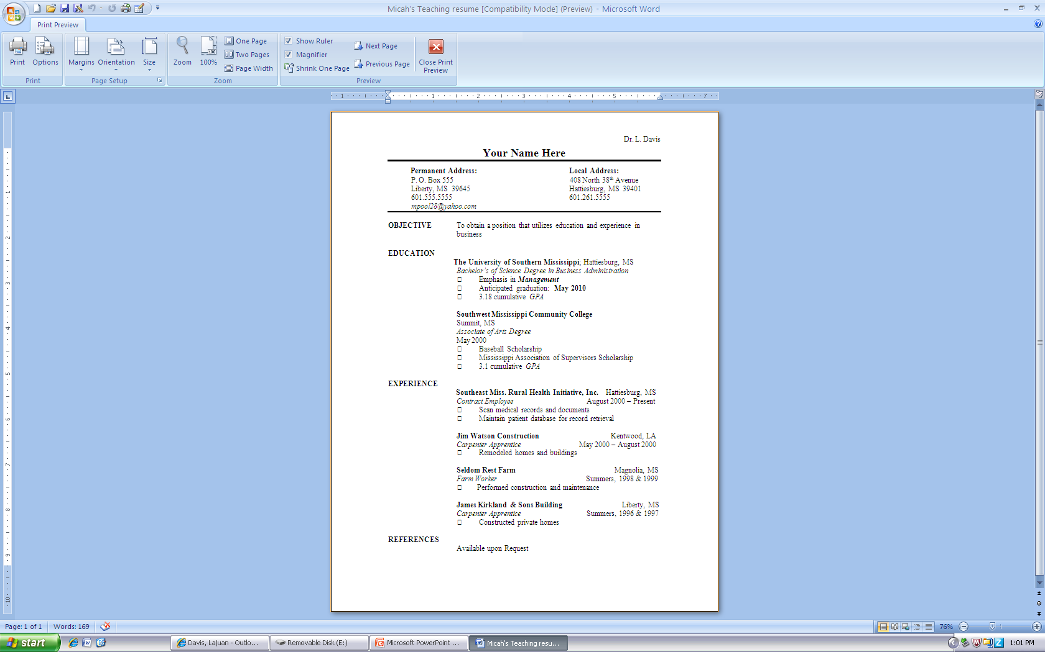
Professional Résumé Creation II
Final Project Handouts\Micah's Teaching resume.doc

Slide 21
Job Interview Tips
Knockem’ Dead: The Ultimate Job Search Guide 2010
    Martin Yate
  Practice! Prepare!
  Learn to turn negatives into positives.
  Say what interviewers need to hear.
  Professionalism is the key.
Print résumé on 100% cotton
paper.

Slide 22
Job Interview Tips Continued . . .
Look the part.
Prepare to answer tough questions.
Research the company (and competitors).
Explain work gaps.
  Fill gaps with educational or volunteer experience.
Smile and be friendly and open.
Follow-up with a handshake, a verbal “thank you,” and a written thank-you note (24 hours).

Slide 23

Job Interview Tips Continued . . .
Network
Have a positive online presence.
Be proactive
  Jobs will not find you; you have to find the job(s).

Slide 24

Professional Image Is More Than Attire and Documents
Watch your attitude; you signed a contract.
Treat all people (including the waiter/waitress) well—etiquette counts!
Use appropriate grammar and pronounce words clearly.
Use the words “please” and
“thank you.”

Slide 25

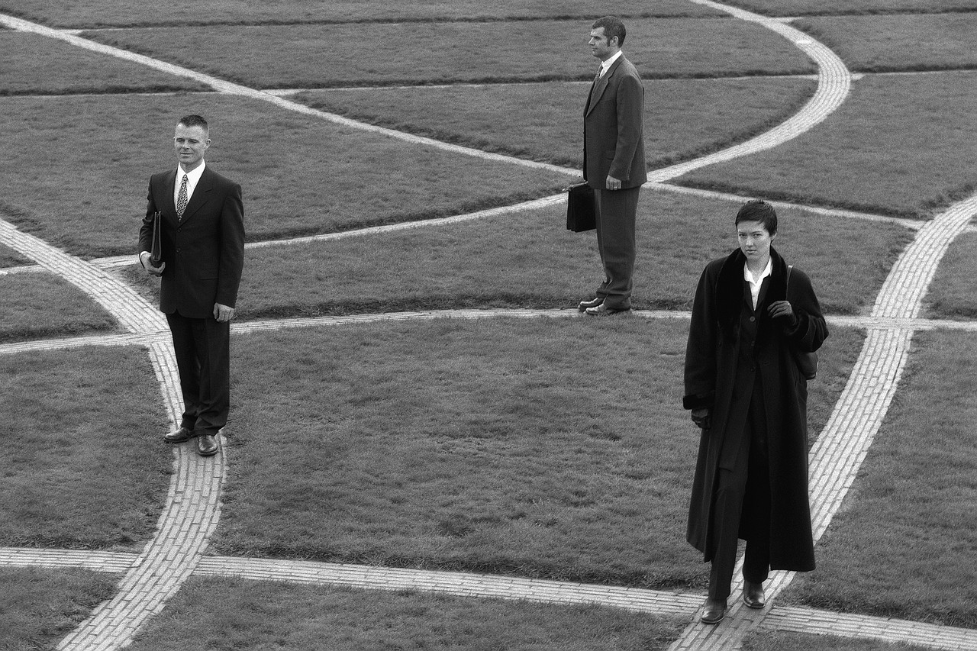


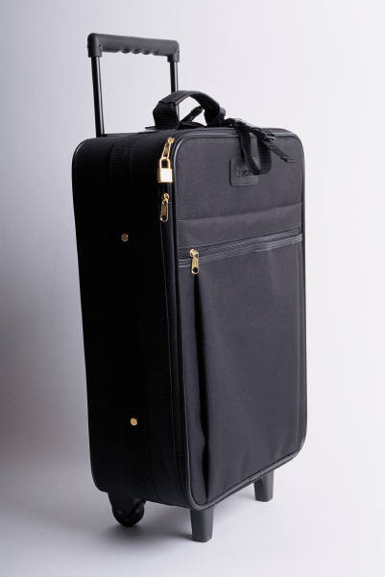


Professional Image “Must Haves”

