Slide 1
Adapting Resumes and Online Research
Notes:
This presentation will be full of information about resumes and the interview process. We will also discuss research about potential or desired employers.

Slide 2
The Importance of a Resume
Serves as your first impression to the employer.
Demonstrates professionalism.
Can lead to an interview.
Notes:
Many of you may be wondering why people say that resumes are so important. Here are three key reasons to have a professional and well-written resume. 1. A resume is usually the first piece of information that an employer will see about you. This means that a resume can be considered the first impression in a majority of cases. If a resume is not professional, it is likely that the employer may assume that about the person who is applying. 2. A resume demonstrates your level of professionalism. If you were an employer looking to hire new employees, what would you think about a resume that is not professional? Would you assume things about that person? 3. A resume gives you a shot at an interview. If the employer is not satisfied with your resume, he or she may not offer an interview.

Slide 3
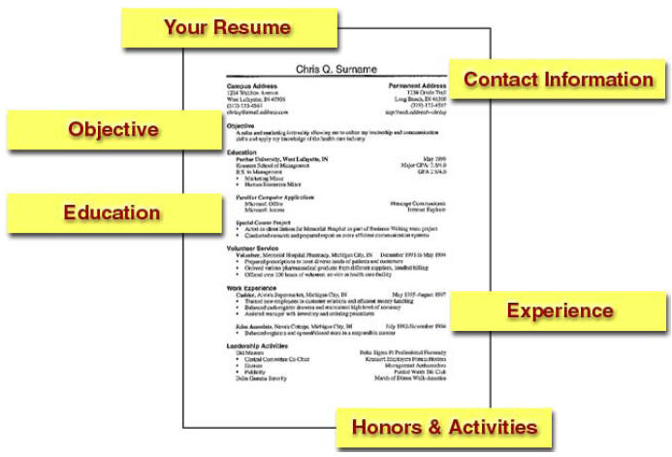
Additional Section: Skills Section
Notes:
Can you recall creating your resume? Here is a brief review of the parts of the resume. The first and very important part of the resume is the contact information section. This section will feature your full name, address, phone number(s), and email(s). It is essential that the information provided is correct and up to date. The next part of the resume is the objective section. We will be focuses on this section during the activity. It is important to have an education section on your resume. This section should include the schools that you have attended such as high schools, universities, community colleges, and professional and technical schools. This section should also include the location of the school, the date of graduation or the anticipated date, the degree or degrees earned, and the grade point average if it is over a 3.0. The experience section should include work and professional experience, work history, field work, volunteer work, and relevant experience. The honors and activities section should include academic awards and scholarships, membership in campus, national, or international organizations, leadership positions held, university and community service positions, work related awards and honors, and the date of the award or involvement should be included. The final section is the skill section. This section will be explained more later in the presentation.

Slide 4
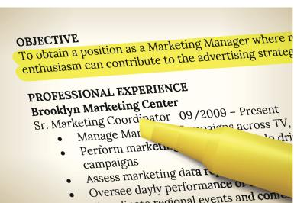
Resume parts: objective
What are you trying to accomplish?
Can prove to employers that you are familiar with the job.
Optional section but it is encouraged.
Must be customized to match the job you are applying for.
Notes:
The objective portion of the resume is intended to provide the employer with your overall objective of obtaining a job or whatever the case may be. The question to be asked when creating this section is: what are you trying to accomplish with this resume? An objective on a resume is optional but is encouraged because it can prove to the employers that you are familiar with the job and possibly even the job requirements. The objective section must be customized to match the job that you are applying for.

Slide 5
Tips for Objective Section
Focus on how you would benefit the employer, not on how the employer would benefit you.
Don't be vague.
Keep it concise and targeted. The best resume objectives contain a desired job title or target.
If you have more than one career goal, create a different resume version for each objective.
Notes:
Focus on how you would benefit the employer, not on how the employer would benefit you. Stay away from resume objectives that state your working preferences, such as "seeking a team-oriented environment that fosters professional development."
Don't be vague. Steer clear from statements that say nothing substantial about your career goal (e.g., "seeking a challenging position with potential for growth and advancement").
Keep it concise and targeted. Hiring managers often sort through hundreds to thousands of resumes to fill one job opening. Make it easy on them by keeping your objective short and to the point. The best resume objectives contain a desired job title or target.
If you have more than one career goal, create a different resume version for each objective.

Slide 6
Resume Parts: Skills
List jobs, activities, projects and special offices.
Think of skills you have gained through those experiences.
Group these skills into three to five job-related skills categories and use these as headings.
List your skills with significant details under the headings.
Arrange headings in order of importance as they relate to your career objective.
Arrange skills under headings in order of importance according to your goal.
Notes:
To create the skills portion of your resume, you should begin by creating a list of activities, projects, and specials offices that you have been a part of. Once you have listed these, think of the skills that you gained through these experiences and list all that you can think of. You should then look at the skills you have listed and group those skills into three to five job-related skills categories. These categories that you have created will be used as headings under the skills portion of your resume. Be sure to arrange the headings in order of importance as they relate to the career objective. You can choose to list the skills under the category headings. Be aware when listing your skills so that this portion is not too large and take up too much room on the resume.

Slide 7
Online Research
Decide what type of research.
Choose which online authorities are suitable.
Use different search engines and key words.
Bookmark and stockpile good content.
Filter and validate the content.
Quote and site the content.
Notes:
We will now look at some information to keep in mind when conducting research online. There are six main ideas that are important to remember in order to conduct beneficial research. You must decide what type of research you are conducting. It is important to choose which online authorities and resources are suitable for the type of research that you are conducting. Be sure to use different search engines and keywords because it may result in different materials. Do not forget to bookmark or stockpile good content that you find and may be able to use. Before using the content found, you should filter and validate the content. Finally, if required, be sure to quote and site the content that was used.

Slide 8
1. Decide what type of research
Hard research: Scientific and objective research.
Proven facts, figures, statistics, and measureable evidence is critical.
Soft research: Topics that are more subjective, cultural, and opinion-based.
Combined soft and hard research.
Having facts and figures while also having opinions to debate.
Notes:
The first important idea of online research is deciding what type of research you will be conducting for the assignment or task. There are two types of research: hard and soft. Hard research is scientific and objective research. This means that search will result in proven facts, figures, statistics, and measureable evidence. Examples of hard research are “Is income tax illegal in the USA?” “Chronic back pain can be treated by a combination of anti-inflammatories, caffeine, and fish oil.” Soft research is more subjective, cultural, and opinion-based. Examples of soft research are “Android phones are better than Apple Iphones.” or “Flickr is the best free photo gallery online.” These two types of research can also be combined to create another type of research. Examples of combined research are “The European economy will collapse by 2017.” During this research, people found statistics about the economy while also making opinionated claims.

Slide 9
2. Choose which online authorities are suitable
Hard research requires hard facts and respected evidence.
Academic journals, government publications, government authorities, scientific and medical content sanctioned by known authorities, archived news
Soft research is often about the opinions of respected online writers/publishers.
Blogs, forums and discussion sites, consumer project review sites, commercial sites that are advertising-driven, tech and computer sites.
Notes:
After you have decided what type of research you are conducting, it is important to choose which online sources or authorities are suitable for the type of research. Because hard research requires hard facts and respected evidence, it is essential to use academic journals, government publications, government authorities, scientific and medical content sanctioned by known authorities, and archived news. Soft research is often about the opinions of respected online writers and publishers. Examples of sites to use for soft research are blogs, forums and discussion sites, consumer project review sites, commercial sites that are advertising-driven, and tech and computer sites. Can you think of some sites that would be suitable for hard or soft research?

Slide 10
3. Use different search engines and keywords
Using various search engines may result in different types of search results.
Using different keywords will broaden the search.
Notes:
Why do you think it is important to use different search engines and keywords when conducting research? Well, by using various search engines, you may find different search results. It could also result in different types of search results. It is also helpful to use different keywords because it will broaden the search.

Slide 11
4. Bookmark and stockpile good content
CTRL-Click the interesting search engine result links. This will spawn a new tab page each time you CTRL-Click.
When you have 3 or 4 new tabs, quickly browse them and do an initial assessment on their credibility.
Bookmark any tabs you consider credible on first glance.
Close the tabs.
Repeat with the next batch of links.
Notes:
The most important part of the research process is to be sure to sift the results and bookmark or save what is important and could be used. The five steps listed will help you sift through the material that you find. When on a page with search results, instead of clicking a result, try holding the Control button and click the link. This will create a new tab page so that you can refer back to the results list. Once you have 3 or 4 tabs open, browse them to see if they are credible. Then bookmark these tabs that you consider credible. Close the tabs and then repeat this process. It may also be helpful to have a word document open and save the URLs to all of the sites that may be useful to you.

Slide 12
5. Filter and validate the content
Carefully consider the author/source and the date of publication.
Be suspicious of personal web pages and pages that have a amateur presentation.
Be suspicious of any ranting, overstating, or overly positive or negative commentary.
Be suspicious of scientific or medical pages that display scientific or medical advertising.
Notes:
Deciding which content is valid may be a challenging part of the research process. Listed are some tips when trying to decide if a source is valid. First consider the author or source and the date of publication. If you are researching a current event, it may not be smart to use an article that was published five years ago. Second, be suspicious of personal web pages and sites that have an amateur presentation. This includes grammatical errors, unprofessional fonts, and poor formatting. Next, be suspicious of any ranting, overstating, or over positive or negative commentary. This could give a red flag that there may be dishonesty or fraudulent motivations behind the writing. Finally, be suspicious of scientific material or medical pages that have scientific or medical advertising displayed.

Slide 13
6. Quote and site the content
Many research tasks require that the material found must be quoted.
Be sure to directly quote the author or summarize the content in your own words so that plagiarism is not a problem.
Citing can be done in the APA or MLA format.
MLA Formatting Help: https://owl.english.purdue.edu/owl/resource/747/01/
APA Formatting Help: https://owl.english.purdue.edu/owl/resource/560/01/
Notes:
The final part of the research process is to quote and cite the content that you used. Some research tasks do not require this but many formal tasks will require citations. It is very important to directly quote the author or summarize in your own words when referring to the research that you found. This will avoid any problems dealing with plagiarism. You can cite your materials in either APA or MLA format. Here are two very helpful links!

Slide 14
Resources
http://netforbeginners.about.com/od/navigatingthenet/tp/How-to-Properly-Research-Online.htm
http://career-advice.monster.com/resumes-cover-letters/resume-writing-tips/whats-your-resume-objective/article.aspx
https://owl.english.purdue.edu/owl/resource/719/05/

